Slide 1
Count and non-count nouns

Slide 2
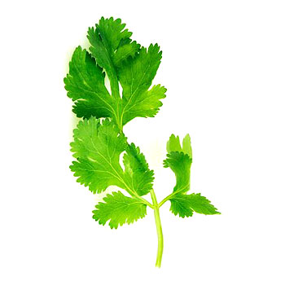
A branch of cilantro/coriander

Slide 3
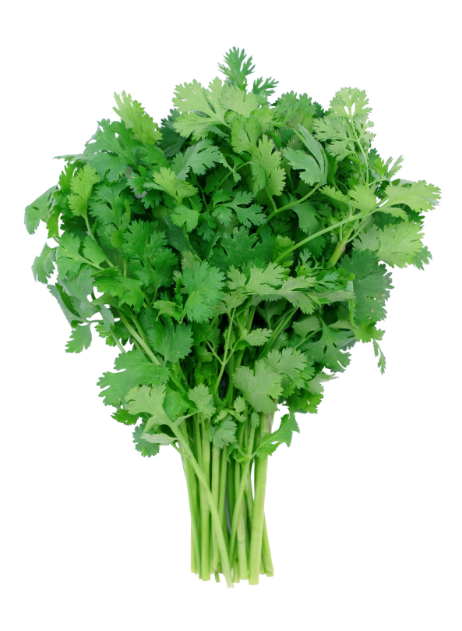
A bunch of cilantro / coriander

Slide 4
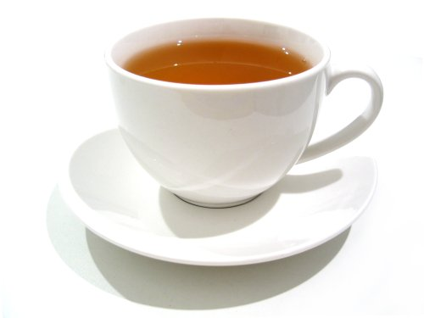
A cup of tea

Slide 5

A drop of water

Slide 6
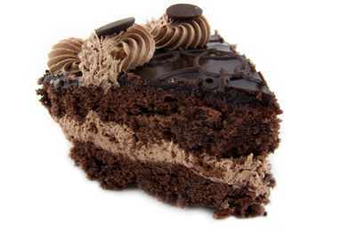
A piece of cake

Slide 7
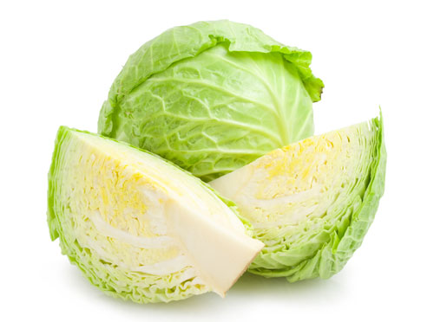
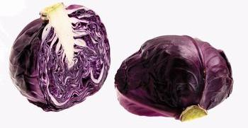
a head cabagge

Slide 8
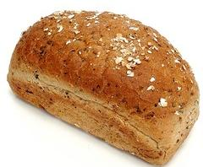
a loaf of bread

Slide 9
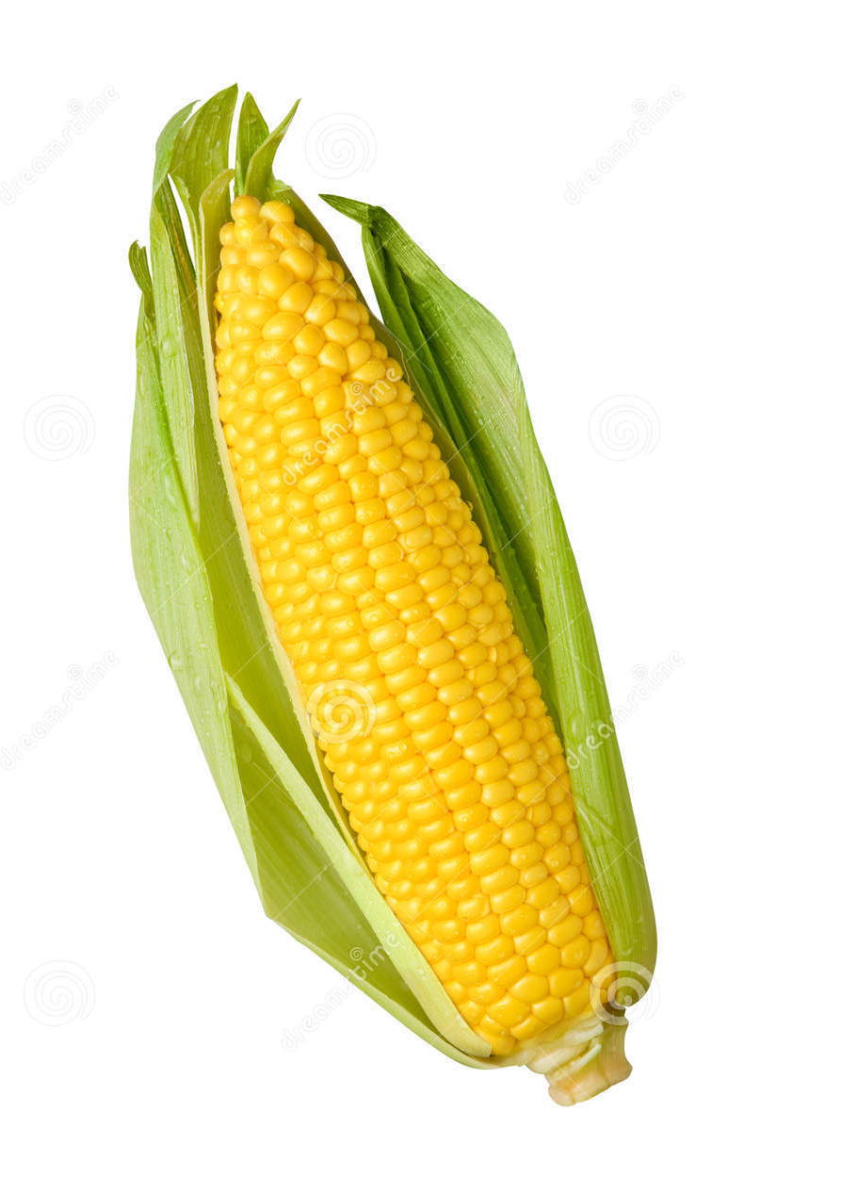
An ear of corn

Slide 10
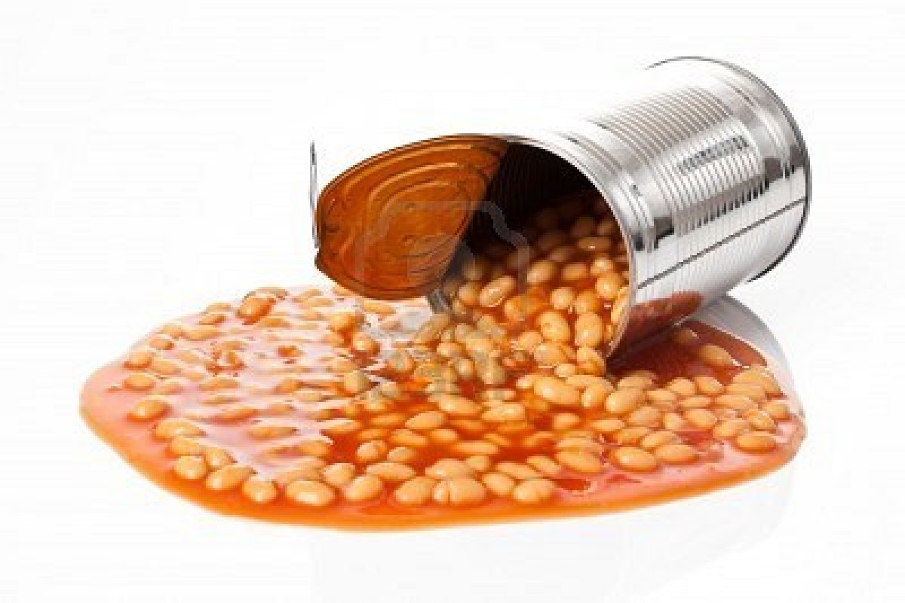
a can of beans

Slide 11
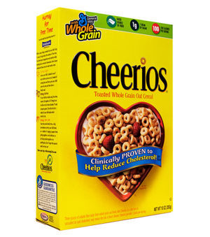
a box of cereal

Slide 12
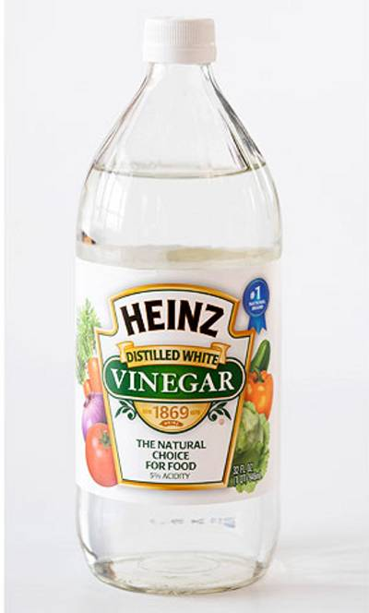
a bottle of vinegar

Slide 13
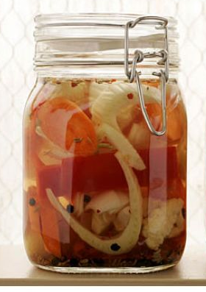
a jar of pickled vegetables

Slide 14
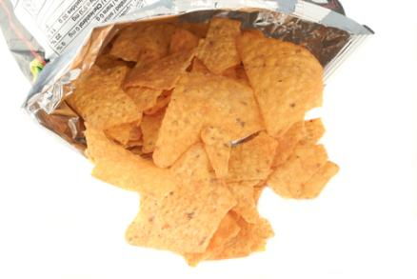
A bag of tortilla chips.

Slide 15
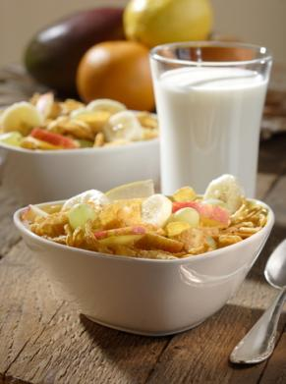
A bowl of cereal
A glass of milk

Slide 16
